Slide 1
Scalable 10 Gbps TCP/IP Stack Architecture for Reconfigurable Hardware
Authors: | David Sidler, Gustavo Alonso, Michaela Blott, Kimon Karras, Kees Vissers
Publisher: | 2015 FCCM
Presenter: | Tzu-Chieh, Lin
Date: | 106/10/24

Slide 2
INTRODUCTION
TCP/IP offload is becoming increasingly popular with standard network interface cards.
More applications beyond high-frequency trading can potentially be accelerated inside an FPGA once TCP with high session count is available inside the fabric.
This paper introduces a novel architecture for a 10 Gbps linerate TCP/IP stack for FPGAs that can scale with the number of sessions and thereby addresses these new applications

Slide 3
Features
Sustained 10 Gbps bandwidth TCP/IP stack through dataflow architecture.
Support for 10,000 concurrent connections with external data buffers, hash-based session lookup, and linear scalability.
Design flexibility through C/C++ design using Vivado HLS.
Control flow features and out-of-order segment processing.
Performance evaluation in a real world setup.

Slide 4
Block diagram of the implemented TCP/IP stack

Slide 5
IP Input Handler
Incoming packets are parsed by the IP Input Handler which also validates IP checksum, determines if they match any of the supported protocols, and forwards the packets to the corresponding modules accordingly.
Invalid packets are discarded and unsupported protocols are forwarded to a separate interface.

Slide 6
ARP module
The ARP module handles address resolution and replies and generates ARP requests when needed.
It contains a lookup table that maps IP addresses to their corresponding MAC addresses. The ARP table is implemented in on-chip block memory (BRAM).

Slide 7
ICMP module.
ICMP enables the exchange of control related messages between two hosts and is processed in the ICMP module.
Supports the most popular subset, namely “echo” or “ping” messages, “destination unreachable” messages, which are created upon packet reception for a closed port, and “TTL expired” messages, which are returned when datagrams with an expired time-to-live (TTL) field are observed.

Slide 8
UDP module & IP Output Handler
The UDP module handles the processing of the corresponding protocol, which is a stateless light-weight protocol that allows for quick and easy data exchange between two end-points.
IP Output Handler merges all the data streams back into a single stream, computes the IP checksum, issues a lookup to the ARP table, formats headers and passes them onto the Ethernet Network Interface for transmission.

Slide 9
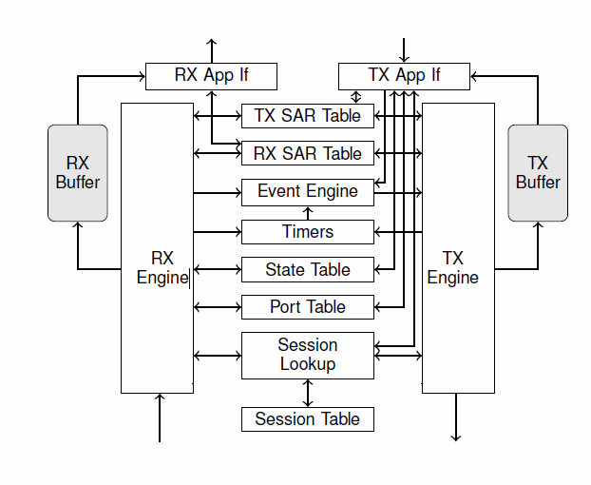
TCP ARCHITECTURE

Slide 10
Session lookup module
The Session lookup module maps the four-tuple (source and destination IP addresses and TCP ports) to a so-called session ID which represents a connection and is used as an index for all other data structures.
At the heart of the lookup problem is a scalable TCAM implementation which is based on a hash table.
In comparison to a traditional TCAM, it uses less resources and scales linearly in its resource requirements with the number of entries.

Slide 11
Port Table & State Table
The Port Table keeps track of the state of each port which can be closed, listen or active.
The State Table stores the current state of each connection. The state values represent the states as specified by RFC793, i.e. CLOSED, SYN-SENT, SYN-RECEIVED, etc.
State values can be updated from the RX Engine but also from the TX App If when a new connection is opened.

Slide 12
Timers module
The Timers module supports all timebased event triggering as required by the protocol.
The “Retransmission Timer” keeps track of the retransmission intervals for packets which have been sent but not acknowledged by the remote host.
The “Probe Timer” is set in case data is available but cannot be sent immediately and transmission has to be postponed.
The “Time-Wait Timer” handles the long time-out in the TIME-WAIT state before the connection reaches the CLOSED state.

Slide 13
Timers module
Each timer is represented by a single table with one entry per connection with one timer per connection for retransmission.
To start the timer, the entry of this connection is set to the value of the time-interval.
Every nth cycle, where n is the maximum number of connections, the entry of each connection with an active time-interval is decremented until zero is reached and the appropriate event is triggered.

Slide 14
Timers module & Event Engine
TCP timers operate with a millisecond granularity. Given a clock period of 6.4 ns(156.25MHz) and one timer access per clock cycle, we can update 156,250 connections per millisecond.
${10}^{−3} ÷\left(6.4 × {10}^{−9}\right)=156250$
Generated events are routed through the Event Engine, together with events from the RX Engine and the TX App If, to the TX Engine.

Slide 15
RX Engine
The RX Engine computes the TCP checksum and verifies its correctness. It extracts meta-information (SEQ number, ACK number, length, IP addresses and TCP ports, window size, TCP flags) and checks if the destination port is accessible.
Issues the session ID lookup of the connection and queries the current state of the arrived segment’s TCP connection from the State and SAR Tables.
If the packet contains a payload that is within the required receive window, then it is written to the RX Buffer and the application is notified.

Slide 16
TX Engine
The main component in the TX Engine is a state machine triggered by the Event Engine.
A reverse lookup is however needed to determine the source and destination IP addresses and TCP ports from the session ID.
Triggers other modules to construct the TCP header, fetch data from external memory for the payload if needed and compute the TCP checksum. Headers and payload are then concatenated and streamed out to the IP Output Handler.

Slide 17
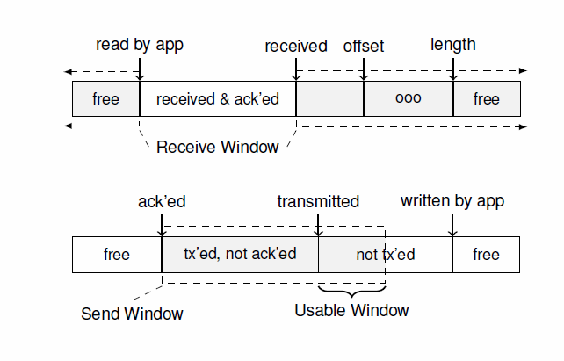
TCP buffer

Slide 18
TCP buffer
TCP operation requires the buffering of payloads to facilitate retransmission and flow control for both receive and transmit.
Allocates two fixed-sized buffers of 64KB per connection. This means that for a design supporting 10,000 connections, a total of 1.3GB of external memory is necessary. External DDR3 memory is used.
The buffers are implemented as circular buffers. Managing each of the buffers requires a set of pointers to keep track of locations in the segment stream.

Slide 19
RX Buffer
These pointers are stored in the TX and RX SAR Tables, which are instrumental for handling all segmentation and reassembly (SAR) functionality as well as maintaining the TCP windows.
For RX, the buffer space is divided as follows: data that was received (and acknowledged) but not read by the application, available free space to receive new segments, and a non-contiguous number of blocks of OOO received data.

Slide 20
Out-of-Order (OOO) Packet Processing
Packets can be dropped or re-ordered due to priorities or simply because they took different routes through the internet.
The OOO segments are arranged into OOO blocks that consist of two pointers: the length of the block & the offset of the block from received. which in essence equates to the sum of the sequence (SEQ) number and payload length of the previous in-order segment.

Slide 21
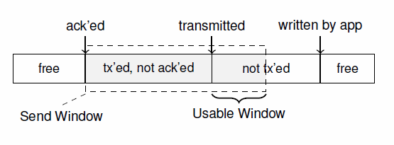
TX Buffer
On the transmission side, we need to keep track of three partitions: transmitted but not yet acknowledged data, data written by the application to the buffer but not yet sent, and finally free space.

Slide 22
EVALUATION
The presented network stack was implemented and validated on a Xilinx VC709 evaluation board which features a Xilinx Virtex7 XC7VX690T FPGA.
The design utilizes two 932MHz DDR3 SODIMMs with 4GB each and one 10G network interface.

Slide 23
Throughput
TCP module uses the default MSS value of 536 B. Taking the packet overhead consisting of Ethernet, IP and TCP headers into account, we can compute the maximum possible TCP throughput to be:

Slide 24
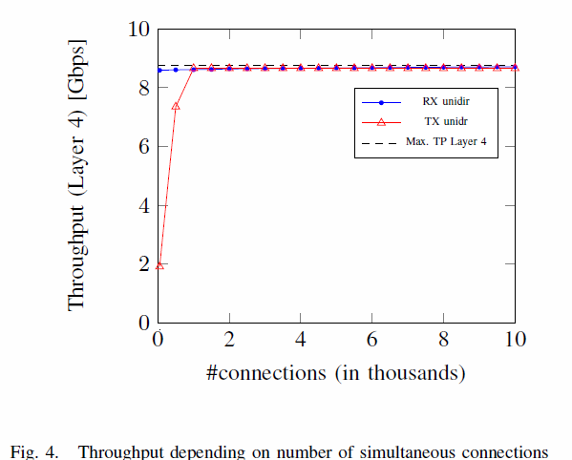
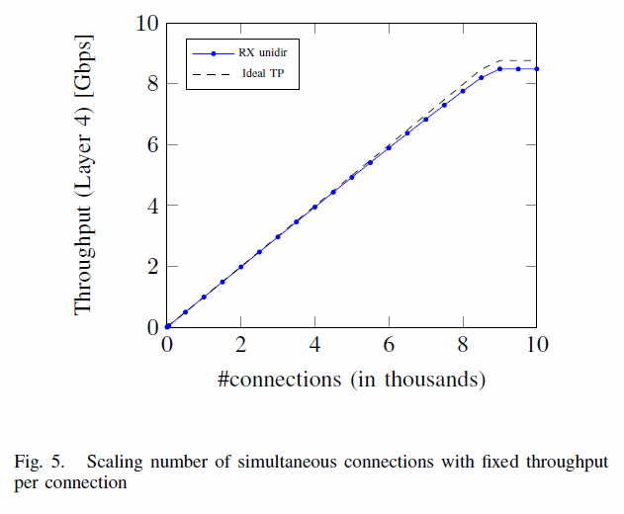

Slide 25
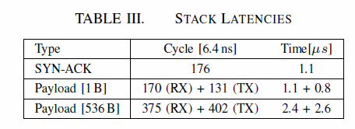
Latency
TABLE III lists the measured results which represent the time from the first word entering our network stack to the first word leaving it.
The remaining latency through GTX, PHY, and MAC adds no more than 300 ns as we have observed in our projects.
Typical network to applications (RX) and application to network (TX) latencies as reported in are in the range of 2μs - 20μs.

Slide 26
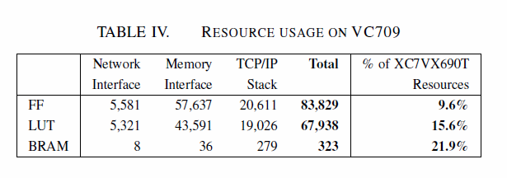
Resources
All our data structures are using BRAMs with mostly linear dependency on the number of supported sessions with a small exception of the FIFO queues within the data-flow architecture.
For 10,000 sessions, this amounts to 21.9%.

